Slide 1
Future Value with Compound Interest
Liberal Arts Mathematics

Slide 2
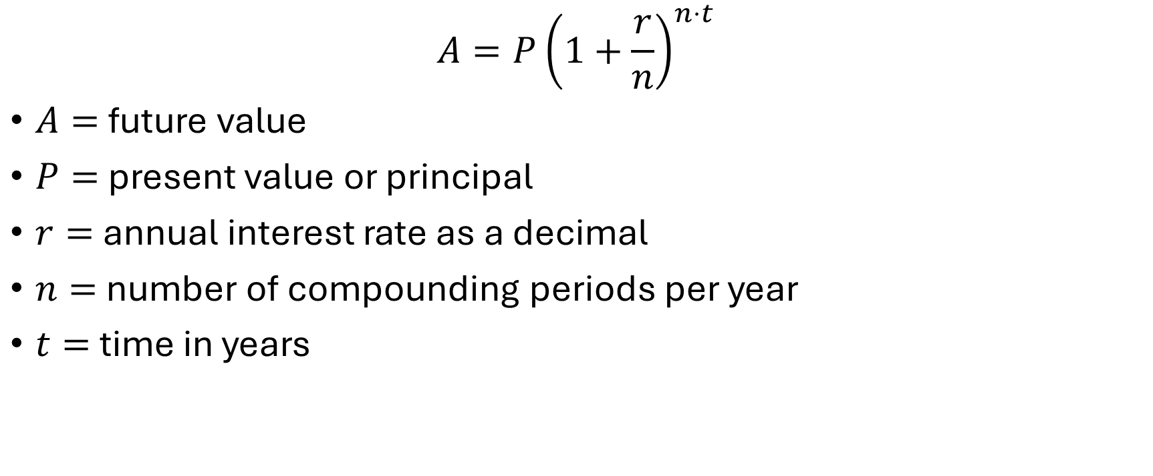
Compound Interest Formula
$$A=P{\left(1+\frac{r}{n}\right)}^{n⋅t}$$
$A=$ future value
$P=$ present value or principal
$r=$ annual interest rate as a decimal
$n=$ number of compounding periods per year
$t=$ time in years

Slide 3
Example 1
Calculate the future value of an account with compound interest. The principal is $3000, the annual interest rate is 3%, compounding is quarterly, and the term is 4 years.

